Slide 1
앱 프로그래밍(1) 과제
Android Studio Report 12주차
소프트웨어융합과_코딩전공
2301111_김진용

Slide 2
Report 1
Activity_report1.xml
<?xml version="1.0" encoding="utf-8"?> <LinearLayout xmlns:android="http://schemas.android.com/apk/res/android" xmlns:app="http://schemas.android.com/apk/res-auto" xmlns:tools="http://schemas.android.com/tools" android:id="@+id/main" android:layout_width="match_parent" android:layout_height="match_parent" android:orientation="vertical" tools:context=".Report1"> <TextView android:layout_width="match_parent" android:layout_height="match_parent" android:gravity="center" android:text="Game Setting" android:textSize="30dp" /> </LinearLayout>

Slide 3
Report1.java
package com.example.week12; import android.content.DialogInterface; import android.content.SharedPreferences; import android.os.Bundle; import android.view.Menu; import android.view.MenuInflater; import android.view.MenuItem; import android.view.View; import android.widget.RadioButton; import android.widget.RadioGroup; import android.widget.SeekBar; import android.widget.TextView; import android.widget.Toast; import androidx.annotation.NonNull; import androidx.appcompat.app.AlertDialog; import androidx.appcompat.app.AppCompatActivity; public class Report1 extends AppCompatActivity { final String PREFER_NAME = "USERID"; private SharedPreferences preferences; @Override protected void onCreate(Bundle savedInstanceState) { super.onCreate(savedInstanceState); setContentView(R.layout.activity_report1); }

Slide 4
@Override public boolean onCreateOptionsMenu(Menu menu) { MenuInflater inflater = getMenuInflater(); inflater.inflate(R.menu.report1, menu); return true; } @Override public boolean onOptionsItemSelected(@NonNull MenuItem item) { int test = item.getItemId(); if (test == R.id.Report1_item1) { GameSettingDialog(); } item.setChecked(true); return true; } private void GameSettingDialog() { AlertDialog.Builder builder = new AlertDialog.Builder(Report1.this); View dialog = View.inflate(this, R.layout.activity_report1_gamesetting, null); TextView soundText = dialog.findViewById(R.id.Report1_soundText), brightnessText = dialog.findViewById(R.id.Report1_brightnessText), difficultyText = dialog.findViewById(R.id.Report1_difficultyText); SeekBar soundSeek = dialog.findViewById(R.id.Report1_soundSeek), brightnessSeek = dialog.findViewById(R.id.Report1_brightnessSeek); RadioButton level_e = dialog.findViewById(R.id.Report1_difficultyRadio1), level_m = dialog.findViewById(R.id.Report1_difficultyRadio2), level_h = dialog.findViewById(R.id.Report1_difficultyRadio3); RadioGroup difficultyGroup = dialog.findViewById(R.id.Report1_difficultyGroup);

Slide 5
sound(soundText, soundSeek); brightness(brightnessText, brightnessSeek); difficulty(difficultyGroup, difficultyText, level_e, level_m, level_h); builder.setIcon(R.drawable.kyungbok); builder.setTitle("환경 설정"); builder.setView(dialog); builder.setPositiveButton("확인", new DialogInterface.OnClickListener() { @Override public void onClick(DialogInterface dialogInterface, int i) { preferences = getSharedPreferences(PREFER_NAME, MODE_PRIVATE); String Sound = soundText.getText().toString(), Brightness = brightnessText.getText().toString(), Difficulty = difficultyText.getText().toString(); if (Sound.isEmpty() || Brightness.isEmpty() || Difficulty.isEmpty()) { Toast.makeText(Report1.this, "입력해 주세요", Toast.LENGTH_SHORT).show(); } else { SharedPreferences.Editor editor = preferences.edit(); editor.putString("sound", Sound) .putString("brightness", Brightness) .putString("difficulty", Difficulty) .apply(); Toast.makeText(Report1.this, "입력되었습니다", Toast.LENGTH_SHORT).show(); } } });

Slide 6
builder.setNegativeButton("종료", new DialogInterface.OnClickListener() { @Override public void onClick(DialogInterface dialogInterface, int i) { Toast.makeText(Report1.this, "종료되었습니다.", Toast.LENGTH_SHORT).show(); } }); builder.create(); builder.show(); } private void sound(TextView soundText, SeekBar soundSeek) { soundSeek.setOnSeekBarChangeListener(new SeekBar.OnSeekBarChangeListener() { @Override public void onProgressChanged(SeekBar seekBar, int i, boolean b) { soundText.setText(String.format("%d", i)); } @Override public void onStartTrackingTouch(SeekBar seekBar) { } @Override public void onStopTrackingTouch(SeekBar seekBar) { } }); }

Slide 7
private void brightness(TextView brightnessText, SeekBar brightnessSeek) { brightnessSeek.setOnSeekBarChangeListener(new SeekBar.OnSeekBarChangeListener() { @Override public void onProgressChanged(SeekBar seekBar, int i, boolean b) { brightnessText.setText(String.format("%d", i)); } @Override public void onStartTrackingTouch(SeekBar seekBar) { } @Override public void onStopTrackingTouch(SeekBar seekBar) { } }); } private void difficulty(RadioGroup difficultyGroup, TextView difficultyText, RadioButton level_e, RadioButton level_m, RadioButton level_h) { difficultyGroup.setOnCheckedChangeListener((group, checkedId) -> { if (checkedId == R.id.Report1_difficultyRadio1) { difficultyText.setText("Easy"); } else if (checkedId == R.id.Report1_difficultyRadio2) {

Slide 8
difficultyText.setText("Medium"); } else if (checkedId == R.id.Report1_difficultyRadio3) { difficultyText.setText("Hard"); } }); } }

Slide 9
Activity_report1_gamesetting.xml
<?xml version="1.0" encoding="utf-8"?> <LinearLayout xmlns:android="http://schemas.android.com/apk/res/android" android:layout_width="match_parent" android:layout_height="wrap_content" android:layout_gravity="center" android:orientation="vertical" android:padding="10dp"> <LinearLayout android:layout_width="match_parent" android:layout_height="wrap_content"> <TextView android:layout_width="wrap_content" android:layout_height="wrap_content" android:text="Sound : " android:textSize="20dp" /> <TextView android:id="@+id/Report1_soundText" android:layout_width="wrap_content" android:layout_height="wrap_content" android:text="0" android:textSize="20dp" />

Slide 10
<TextView android:layout_width="wrap_content" android:layout_height="wrap_content" android:text=" / 100" android:textSize="20dp" /> </LinearLayout> <SeekBar android:id="@+id/Report1_soundSeek" android:layout_width="match_parent" android:layout_height="wrap_content" android:layout_margin="10dp" /> <LinearLayout android:layout_width="match_parent" android:layout_height="wrap_content" android:layout_marginTop="30dp"> <TextView android:layout_width="wrap_content" android:layout_height="wrap_content" android:text="Brightness : " android:textSize="20dp" /> <TextView android:id="@+id/Report1_brightnessText" android:layout_width="wrap_content"

Slide 11
android:layout_height="wrap_content" android:text="0" android:textSize="20dp" /> <TextView android:layout_width="wrap_content" android:layout_height="wrap_content" android:text=" / 100" android:textSize="20dp" /> </LinearLayout> <SeekBar android:id="@+id/Report1_brightnessSeek" android:layout_width="match_parent" android:layout_height="wrap_content" android:layout_margin="10dp" /> <LinearLayout android:layout_width="match_parent" android:layout_height="wrap_content" android:layout_marginTop="30dp"> <TextView android:layout_width="wrap_content" android:layout_height="wrap_content" android:text="Difficulty Level : " android:textSize="20dp" />

Slide 12
<TextView android:id="@+id/Report1_difficultyText" android:layout_width="wrap_content" android:layout_height="wrap_content" android:text="Easy" android:textSize="20dp" /> </LinearLayout> <RadioGroup android:id="@+id/Report1_difficultyGroup" android:layout_width="match_parent" android:layout_height="wrap_content" android:orientation="horizontal"> <RadioButton android:id="@+id/Report1_difficultyRadio1" android:layout_width="0dp" android:layout_height="wrap_content" android:layout_weight="1" android:checked="true" android:text="Easy" /> <RadioButton android:id="@+id/Report1_difficultyRadio2" android:layout_width="0dp" android:layout_height="wrap_content" android:layout_weight="1" android:text="Medium" />

Slide 13
<RadioButton android:id="@+id/Report1_difficultyRadio3" android:layout_width="0dp" android:layout_height="wrap_content" android:layout_weight="1" android:text="Hard" /> </RadioGroup> </LinearLayout>

Slide 14
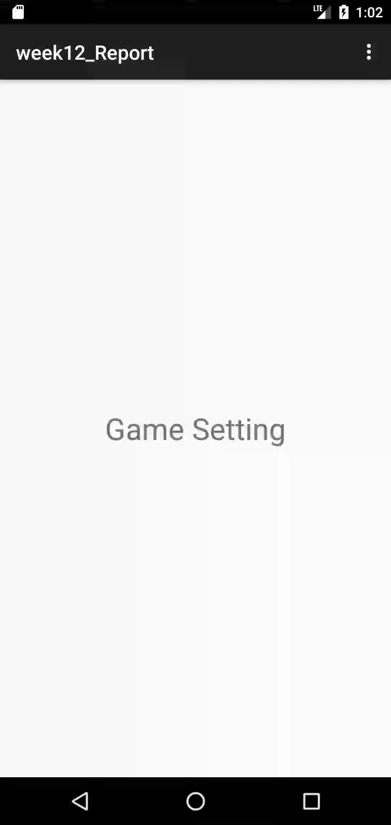
Report 1
실행화면

Slide 15
Report 2
Activity_report2.xml
<?xml version="1.0" encoding="utf-8"?> <LinearLayout android:orientation="vertical" xmlns:android="http://schemas.android.com/apk/res/android" xmlns:app="http://schemas.android.com/apk/res-auto" xmlns:tools="http://schemas.android.com/tools" android:id="@+id/main" android:layout_width="match_parent" android:layout_height="match_parent" tools:context=".Report2"> <TextView android:layout_width="match_parent" android:layout_height="match_parent" android:gravity="center" android:text="환경 설정" android:textSize="30dp" /> </LinearLayout>

Slide 16
report2_settings2.xml
<?xml version="1.0" encoding="utf-8"?> <PreferenceScreen xmlns:android="http://schemas.android.com/apk/res/android" xmlns:app="http://schemas.android.com/apk/res-auto"> <ListPreference android:defaultValue="0" android:dialogTitle="알림음" android:entries="@array/AlertSound_entries" android:entryValues="@array/AlertSound_values" android:key="AlertSound" android:negativeButtonText="CANCEL" android:title="알림음" /> <MultiSelectListPreference android:dialogTitle="취미" android:key="hobby_preferences" android:negativeButtonText="CANCEL" android:positiveButtonText="OK" android:title="취미 선택" android:summary="원하는 취미를 선택하세요." android:entries="@array/Hobby_entries" android:entryValues="@array/Hobby_values" /> <Preference android:key="Rington" android:title="Choose Alarms" android:summary="rington을 선택하세요" /> </PreferenceScreen>

Slide 17
Activity_report2_admin.xml
<?xml version="1.0" encoding="utf-8"?> <LinearLayout xmlns:android="http://schemas.android.com/apk/res/android" xmlns:app="http://schemas.android.com/apk/res-auto" xmlns:tools="http://schemas.android.com/tools" android:id="@+id/main" android:layout_width="match_parent" android:layout_height="match_parent" tools:context=".Report2_admin"> <TextView android:layout_width="match_parent" android:layout_height="wrap_content" android:text="이 페이지는 Preference Sub Activity 입니다." /> </LinearLayout>

Slide 18
report2.xml
<?xml version="1.0" encoding="utf-8"?> <menu xmlns:android="http://schemas.android.com/apk/res/android"> <group android:checkableBehavior="single"> <item android:id="@+id/Report2_item1" android:checkable="false" android:title="환경 설정1" /> <item android:id="@+id/Report2_item2" android:checkable="false" android:title="환경 설정2" /> <item android:id="@+id/Report2_item3" android:checkable="false" android:title="환경 설정3" /> <item android:id="@+id/Report2_item4" android:checkable="false" android:title="환경 설정4" /> </group> </menu>

Slide 19
report2.java
package com.example.week12; import android.content.Intent; import android.os.Bundle; import android.provider.Settings; import android.view.Menu; import android.view.MenuInflater; import android.view.MenuItem; import androidx.activity.EdgeToEdge; import androidx.annotation.NonNull; import androidx.appcompat.app.AppCompatActivity; import androidx.core.graphics.Insets; import androidx.core.view.ViewCompat; import androidx.core.view.WindowInsetsCompat; import androidx.fragment.app.FragmentManager; import androidx.fragment.app.FragmentTransaction; public class Report2 extends AppCompatActivity { @Override protected void onCreate(Bundle savedInstanceState) { super.onCreate(savedInstanceState); setContentView(R.layout.activity_report2); }

Slide 20
@Override public boolean onCreateOptionsMenu(Menu menu) { MenuInflater inflater = getMenuInflater(); inflater.inflate(R.menu.report2, menu); return true; } @Override public boolean onOptionsItemSelected(@NonNull MenuItem item) { Intent intent = null; int check = item.getItemId(); if (check == R.id.Report2_item1) { intent = new Intent(getBaseContext(), Report2_Settings1.class); } else if (check == R.id.Report2_item2) { intent = new Intent(getBaseContext(), Report2_Settings2.class); } else if (check == R.id.Report2_item3) { intent = new Intent(getBaseContext(), Report2_Settings3.class); } else if (check == R.id.Report2_item4) { intent = new Intent(getBaseContext(), Report2_Settings4.class); } startActivity(intent); item.setChecked(true); return true; } }

Slide 21
Report2_admin.java
package com.example.week12; import android.os.Bundle; import androidx.appcompat.app.AppCompatActivity; public class Report2_admin extends AppCompatActivity { @Override protected void onCreate(Bundle savedInstanceState) { super.onCreate(savedInstanceState); setContentView(R.layout.activity_report2_admin); } }

Slide 22
Report2_settings1.java
package com.example.week12; import android.os.Bundle; import android.preference.PreferenceActivity; import android.preference.PreferenceScreen; import androidx.annotation.Nullable; public class Report2_Settings1 extends PreferenceActivity { @Override protected void onCreate(@Nullable Bundle savedInstanceState) { super.onCreate(savedInstanceState); addPreferencesFromResource(R.xml.report2_settings1); } }

Slide 23
Report2_settings2.java
package com.example.week12; import android.content.DialogInterface; import android.content.SharedPreferences; import android.graphics.Color; import android.os.Bundle; import android.preference.ListPreference; import android.preference.Preference; import android.preference.PreferenceActivity; import android.preference.PreferenceScreen; import android.widget.Toast; import androidx.appcompat.app.AlertDialog; import androidx.preference.PreferenceManager; import org.jetbrains.annotations.Nullable; import java.util.ArrayList; import java.util.HashSet; import java.util.List; import java.util.Set; public class Report2_Settings2 extends PreferenceActivity { private SharedPreferences sharedPreferences;

Slide 24
@Override protected void onCreate(Bundle savedInstanceState) { super.onCreate(savedInstanceState); addPreferencesFromResource(R.xml.report2_settings2); sharedPreferences = PreferenceManager.getDefaultSharedPreferences(this); } @Override public boolean onPreferenceTreeClick(PreferenceScreen preferenceScreen, Preference preference) { if ("Rington".equals(preference.getKey())) { showRingtonDialog(); return true; } return super.onPreferenceTreeClick(preferenceScreen, preference); } private void showRingtonDialog() { String[] ringtonOptions = getResources().getStringArray(R.array.Rington_entries); final String[] ringtonValues = getResources().getStringArray(R.array.Rington_values); String savedRingtonValue = sharedPreferences.getString("selected_rington", ringtonValues[0]); int selectedIndex = 0; for (int i = 0; i < ringtonValues.length; i++) { if (ringtonValues[i].equals(savedRingtonValue)) { selectedIndex = i; break; } }

Slide 25
AlertDialog.Builder builder = new AlertDialog.Builder(this); builder.setTitle("Choose Alarm") .setSingleChoiceItems(ringtonOptions, selectedIndex, new DialogInterface.OnClickListener() { @Override public void onClick(DialogInterface dialog, int which) { SharedPreferences.Editor editor = sharedPreferences.edit(); editor.putString("selected_rington", ringtonValues[which]); editor.apply(); } }) .setPositiveButton("OK", null) .setNegativeButton("CANCEL", null); builder.create().show(); } }

Slide 26
Report2_settings3.java
package com.example.week12; import android.os.Bundle; import android.preference.PreferenceActivity; import android.preference.PreferenceScreen; import org.jetbrains.annotations.Nullable; public class Report2_Settings3 extends PreferenceActivity { @Override protected void onCreate(@Nullable Bundle savedInstanceState) { super.onCreate(savedInstanceState); addPreferencesFromResource(R.xml.report2_settings3); } }

Slide 27
Report2_settings4.java
package com.example.week12; import android.content.Intent; import android.content.SharedPreferences; import android.os.Bundle; import android.preference.Preference; import android.preference.PreferenceActivity; import androidx.preference.PreferenceManager; import org.jetbrains.annotations.Nullable; public class Report2_Settings4 extends PreferenceActivity { private SharedPreferences sharedPreferences; @Override protected void onCreate(@Nullable Bundle savedInstanceState) { super.onCreate(savedInstanceState); addPreferencesFromResource(R.xml.report2_settings4); sharedPreferences = PreferenceManager.getDefaultSharedPreferences(this); Preference adminPreference = findPreference("admin"); if (adminPreference != null) { adminPreference.setOnPreferenceClickListener(preference -> { Intent intent = new Intent(Report2_Settings4.this, Report2_admin.class); startActivity(intent); return true; }); } } }

Slide 28
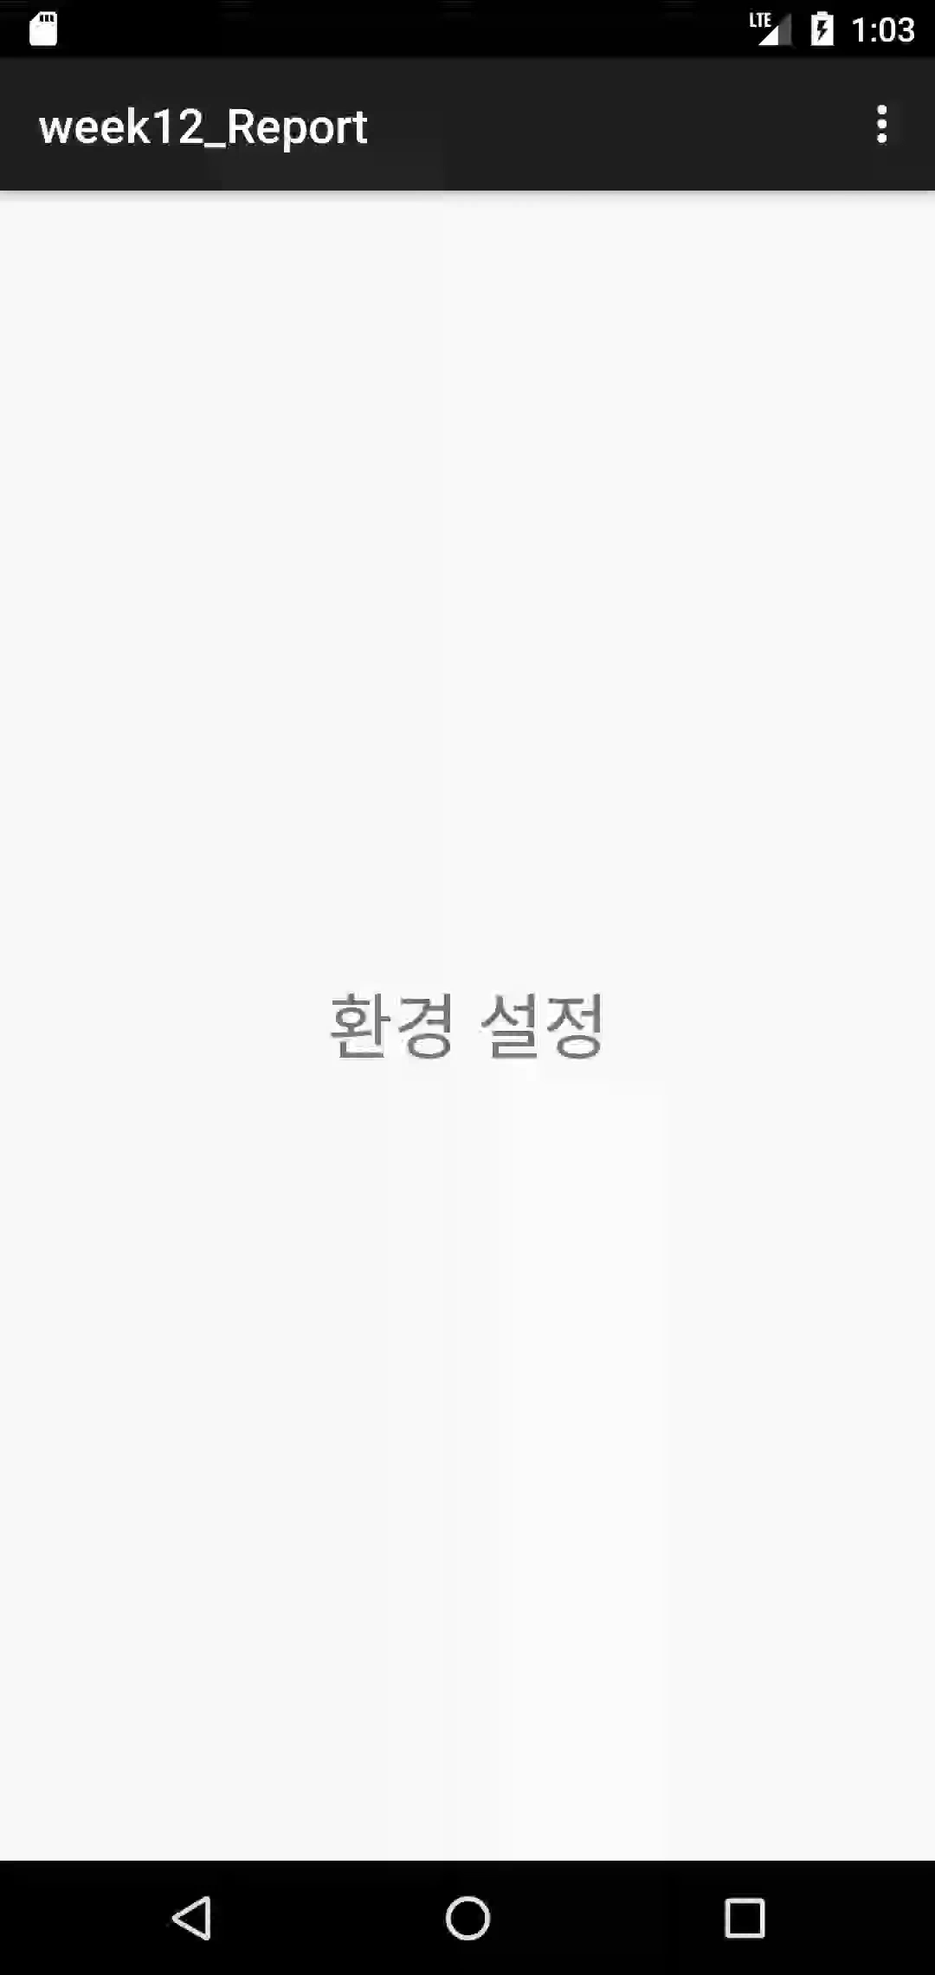
Report 2
실행화면

Slide 29
Report 3
Activity_report3.xml
<?xml version="1.0" encoding="utf-8"?> <LinearLayout xmlns:android="http://schemas.android.com/apk/res/android" xmlns:app="http://schemas.android.com/apk/res-auto" xmlns:tools="http://schemas.android.com/tools" android:id="@+id/main" android:layout_width="match_parent" android:layout_height="match_parent" android:orientation="vertical" tools:context=".Report3"> <Button android:id="@+id/Report3_button" android:layout_width="wrap_content" android:layout_height="wrap_content" android:layout_gravity="center" android:text="적용하기" /> <TextView android:id="@+id/Report3_text" android:layout_width="wrap_content" android:layout_height="wrap_content" android:layout_gravity="center" android:textSize="40dp" android:text="Hello Guest" /> </LinearLayout>

Slide 30
Activity_report3_Inputname.xml
<?xml version="1.0" encoding="utf-8"?> <LinearLayout xmlns:android="http://schemas.android.com/apk/res/android" android:layout_width="match_parent" android:layout_height="wrap_content" android:layout_gravity="center" android:orientation="vertical" android:padding="10dp"> <EditText android:id="@+id/Report3_Edit" android:layout_width="match_parent" android:layout_height="wrap_content" /> </LinearLayout>

Slide 31
report3.xml
<?xml version="1.0" encoding="utf-8"?> <menu xmlns:android="http://schemas.android.com/apk/res/android"> <group android:checkableBehavior="single"> <item android:id="@+id/Report3_item1" android:checkable="false" android:title="Settings" /> </group> </menu>

Slide 32
Report3_settings.xml
<?xml version="1.0" encoding="utf-8"?> <PreferenceScreen xmlns:android="http://schemas.android.com/apk/res/android"> <EditTextPreference android:defaultValue="" android:key="Input_name" android:title="Input your name" /> <ListPreference android:defaultValue="#000000" android:dialogTitle="Select your text color?" android:entries="@array/TextColor_entries" android:entryValues="@array/TextColor_values" android:key="TextColor" android:title="Select your text color?" /> <CheckBoxPreference android:defaultValue="false" android:key="boldText" android:title="Display bold text?" android:summary="Select whether the app display bold text." /> <ListPreference android:defaultValue="#000000" android:dialogTitle="Select your screen color?" android:entries="@array/ScreenColor_entries" android:entryValues="@array/ScreenColor_values" android:key="ScreenColor" android:negativeButtonText="CANCLE" android:title="Select your screen color?" /> </PreferenceScreen>

Slide 33
report3.java
package com.example.week12; import android.content.Intent; import android.os.Bundle; import android.view.Menu; import android.view.MenuInflater; import android.view.MenuItem; import androidx.annotation.NonNull; import androidx.appcompat.app.AppCompatActivity; public class Report3 extends AppCompatActivity { @Override protected void onCreate(Bundle savedInstanceState) { super.onCreate(savedInstanceState); setContentView(R.layout.activity_report3); } @Override public boolean onCreateOptionsMenu(Menu menu) { MenuInflater inflater = getMenuInflater(); inflater.inflate(R.menu.report3, menu); return true; }

Slide 34
@Override public boolean onOptionsItemSelected(@NonNull MenuItem item) { int itemId = item.getItemId(); // 메뉴 항목 확인 및 Intent 생성 if (itemId == R.id.Report3_item1) { Intent intent = new Intent(this, Report3_Settings.class); startActivity(intent); return true; } return super.onOptionsItemSelected(item); } }

Slide 35
Report3_settings.java
package com.example.week12; import android.content.SharedPreferences; import android.graphics.Color; import android.graphics.Typeface; import android.os.Bundle; import android.preference.Preference; import android.preference.PreferenceActivity; import android.preference.PreferenceScreen; import android.view.LayoutInflater; import android.view.View; import android.widget.Button; import android.widget.EditText; import android.widget.LinearLayout; import android.widget.TextView; import android.widget.Toast; import androidx.appcompat.app.AlertDialog; import androidx.preference.ListPreference; public class Report3_Settings extends PreferenceActivity { private SharedPreferences preferences; private LinearLayout layout; private Button button; private TextView textView;

Slide 36
@Override protected void onCreate(Bundle savedInstanceState) { super.onCreate(savedInstanceState); addPreferencesFromResource(R.xml.report3_settings); preferences = getSharedPreferences("USERID", MODE_PRIVATE); Preference namePreference = findPreference("Input_name"); if (namePreference != null) { namePreference.setOnPreferenceClickListener(preference -> { showInputDialog(); return true; }); } private void showInputDialog() { View dialogView = LayoutInflater.from(this).inflate(R.layout.activity_report3_inputname, null); EditText editText = dialogView.findViewById(R.id.Report3_Edit); String name = editText.getText().toString().trim(); SharedPreferences.Editor editor = preferences.edit(); editor.putString("Input_name", name); editor.apply(); } }

Slide 37
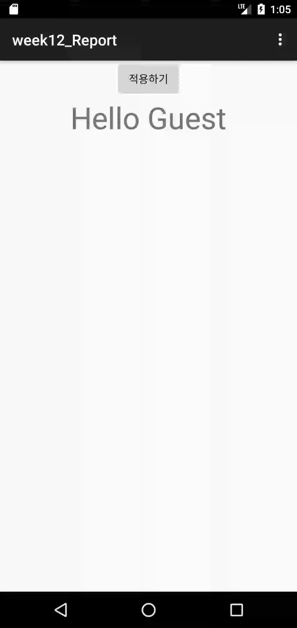
Report 3
실행화면

Slide 38
Arrays.xml
<resources> <!-- Reply Preference --> <string-array name="reply_entries"> <item>Reply</item> <item>Reply to all</item> </string-array> <string-array name="reply_values"> <item>reply</item> <item>reply_all</item> </string-array> <string-array name="AlertSound_entries"> <item>카톡</item> <item>카톡왔음</item> <item>카톡카톡</item> <item>카카오톡</item> </string-array> <string-array name="AlertSound_values"> <item>카톡</item> <item>카톡왔음</item> <item>카톡카톡</item> <item>카카오톡</item> </string-array>

Slide 39
Arrays.xml
<string-array name="Rington_entries"> <item>Aquila</item> <item>Argo Navis</item> <item>Atria</item> <item>Backroad</item> <item>Beat Plucker</item> <item>Bell Phone</item> <item>Bentley Dubs</item> <item>Big Easy</item> <item>Bird Loop</item> </string-array> <string-array name="Rington_values"> <item>Aquila</item> <item>Argo Navis</item> <item>Atria</item> <item>Backroad</item> <item>Beat Plucker</item> <item>Bell Phone</item> <item>Bentley Dubs</item> <item>Big Easy</item> <item>Bird Loop</item> </string-array>

Slide 40
Arrays.xml
<string-array name="TextColor_entries"> <item>Red(빨간색)</item> <item>Blue(파랑색)</item> <item>Green(녹색)</item> <item>Black(검정색)</item> </string-array> <string-array name="TextColor_values"> <item>#ff0000</item> <item>#0000ff</item> <item>#00ff00</item> <item>#000000</item> </string-array> <string-array name="ScreenColor_entries"> <item>Red(빨간색)</item> <item>Blue(파랑색)</item> <item>Green(녹색)</item> <item>Black(검정색)</item> </string-array> <string-array name="ScreenColor_values"> <item>#ff0000</item> <item>#0000ff</item> <item>#00ff00</item> <item>#000000</item> </string-array> </resources>

